Slide 1
FIT3143 Lab 2
Julia Mallard, Nam Quang Tran

Slide 2
Task 1 – Prime Search using Message Passing Interface (Open MPI)

Slide 3
Distribution of work (naive)
Rank | Work done
0 | 4,944,695
1 | 8,011,836
2 | 9,846,491
3 | 11,297,539
Naive way of distributing work, work is split up into 4 even blocks
However, higher ranks (who will get blocks of higher values) will have to do more work
In this example, rank 3 will have to do 2.28x more work, which is not ideal, as Rank 0 has to wait on all to report back the output.
Rank 3 will be the bottleneck.
4 processes and n = 1000000

Slide 4
Distribution of work (block cyclic round robin)
Rank | Work done
0 | 8,012,598
1 | 8,411,874
2 | 8,703,415
3 | 8,972,674
Instead of 4 big blocks, cut the work into smaller slices
This balances the workload, each rank receives a similar mix of small and large numbers, rather than one rank being left with the expensive high end of the range.
This reduces the worst case difference of work done between two ranks from 2.24x to 1.12x
4 processes and n = 1000000

Slide 5
What could we have used instead?
Why did we use 8 slices per process? Why not more?
The law of diminishing returns applies here, and the amount the work evens out reduces as you go up to 16 or 64 slices.
Why use blocks at all? Why not use round robin on the individual numbers, instead of slices?
If a certain number of processes are used, some processes can end up with numbers that are only multiples of 2, or other numbers, meaning that some processes can essentially find no/very little primes.

Slide 6
What could we have used instead?
Is there any other load balancer than cyclic round robin?
Yes, there are methods such as folded/reverse pairing and dynamic self-scheduling, however we did not believe that these methods were necessary, as the block cyclic round robin was fast enough for how simple it was, these other methods are unnecessarily complex for little or no speed up.
Could any other methods of prime searching be used?
The Sieve of Eratosthenes was mentioned in our feedback for Lab 1, however, we already had a prime searching function that used a square root upper bound, so we wanted to reuse it for apples to apples comparison’s sake.

Slide 7
Speed up with varying no. of processors
processors | Time (secs) | speedup | efficiency
1 | 0.4424 | 1x | 100%
2 | 0.2568 | 1.72x | 86.1%
3 | 0.1952 | 2.27x | 75.6%
4 | 0.1616 | 2.74x | 68.4%
6 | 0.1623 | 2.73x | 45.4%
8 | 0.1656 | 2.67x | 33.4%
12 | 0.1739 | 2.54x | 25.4%
When processors used is within 1-4, the speedup is reasonable, staying within ⅔ efficiency, even if it does drop off as processors approaches 4. However, when the processors used is greater than 4, the speedup actually gets worse. This is because we have to make use of the efficiency cores, which have a much lower clock speed and processing power than the super cores, and the communication and scheduling of these processors causes overhead.
Run on Apple M5 (4 super, 6 efficiency cores)
n=10,000,000

Slide 8
Speed up with varying n
n | Time (secs) 1 procs | Time (secs) 4 procs | Speedup | efficiency
10^5 | 0.0013 s | 0.0029 s | 0.44x | 11.1%
3*10^5 | 0.0044 s | 0.0067 s | 0.66x | 16.6%
10^6 | 0.0203 s | 0.0201 s | 1.01x | 25.3%
3*10^6 | 0.0856 s | 0.0458 s | 1.87x | 46.7%
10^7 | 0.4302 s | 0.1591 s | 2.70x | 67.6%
3*10^7 | 1.9692 s | 0.6581 s | 2.99x | 74.8%
10^8 | 10.6936 s | 3.4018 s | 3.14x | 78.6%
When n is below 10^6, there is no speed up at all. This is because of the MPI overhead of having to schedule and run 4 processors at the same time. As n increases, the portion of work dedicated overhead, and actual prime computation flips, causing the speedup to gradually approach the theoretical limit of 4, as n gets higher.
Run on Apple M5 (4 super, 6 efficiency cores)
n=10,000,000

Slide 9
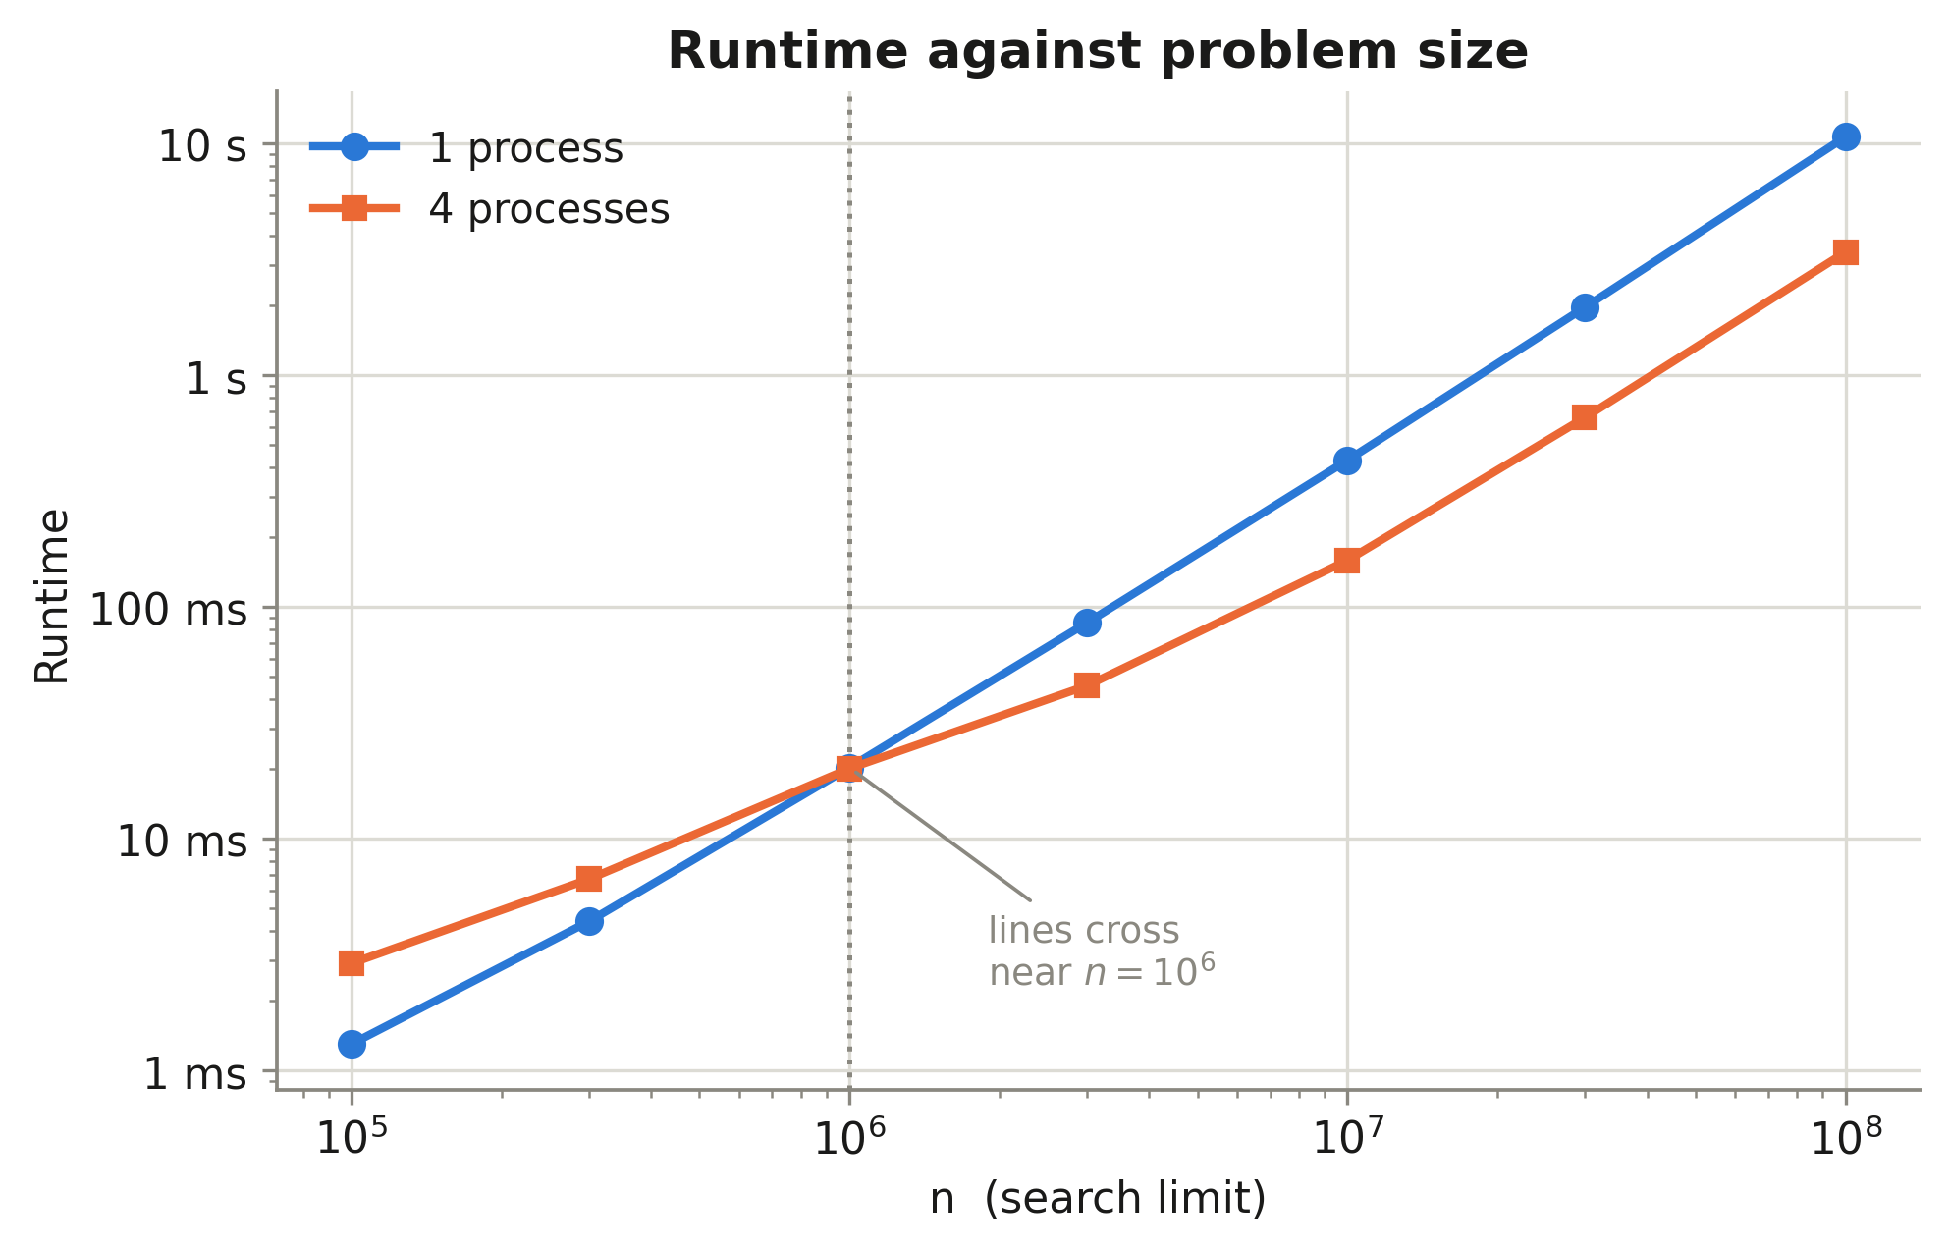
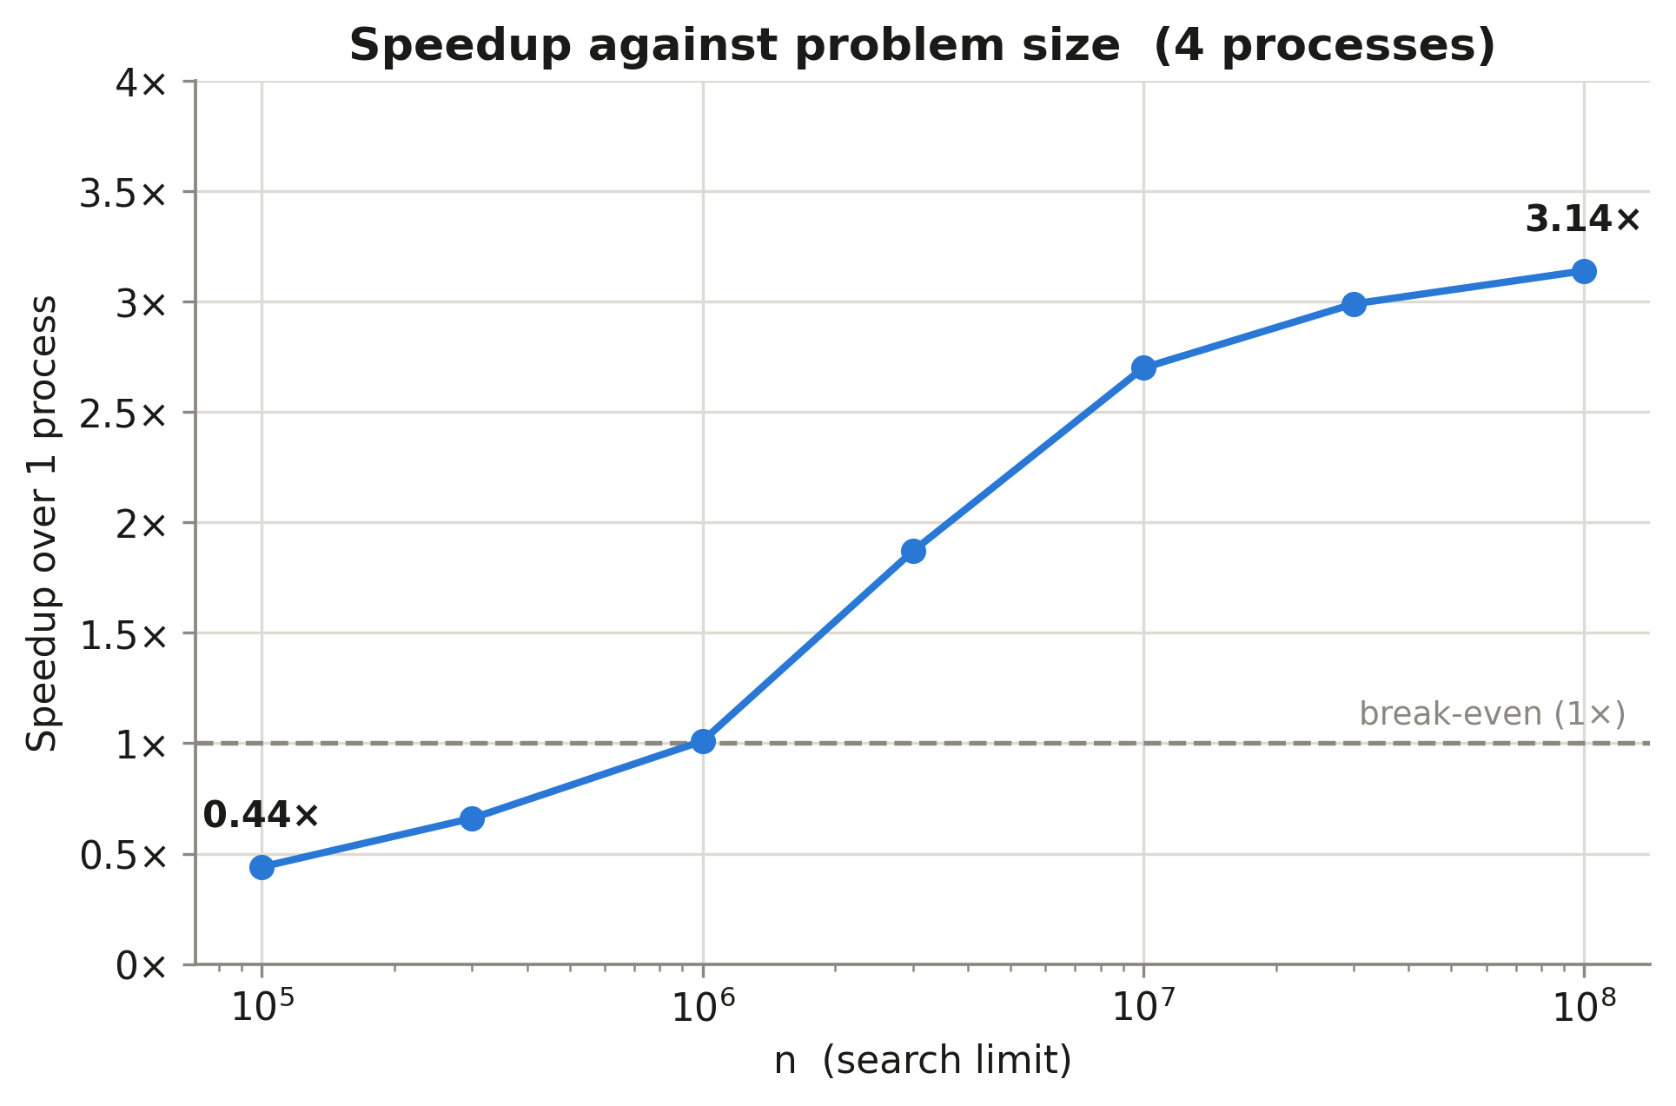

Slide 10
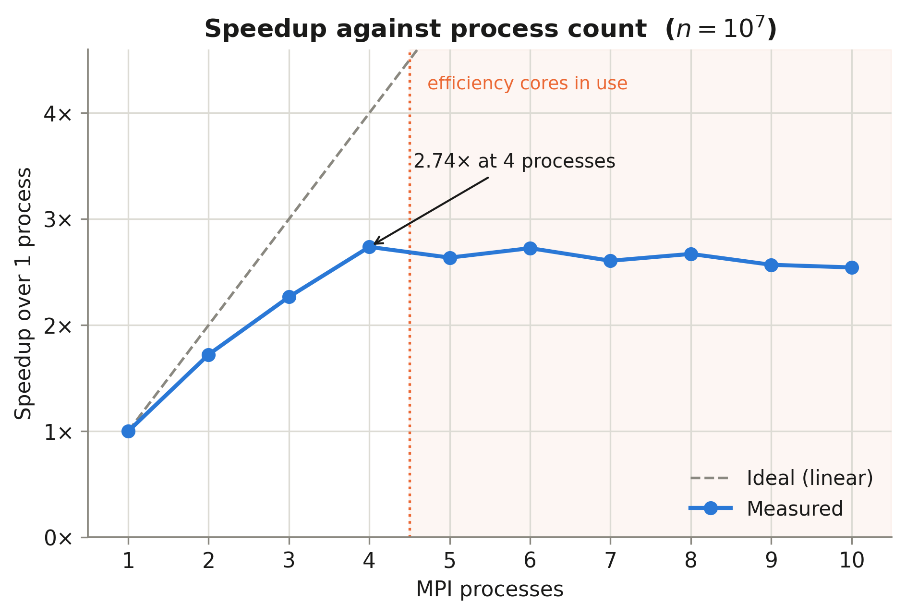

Slide 11
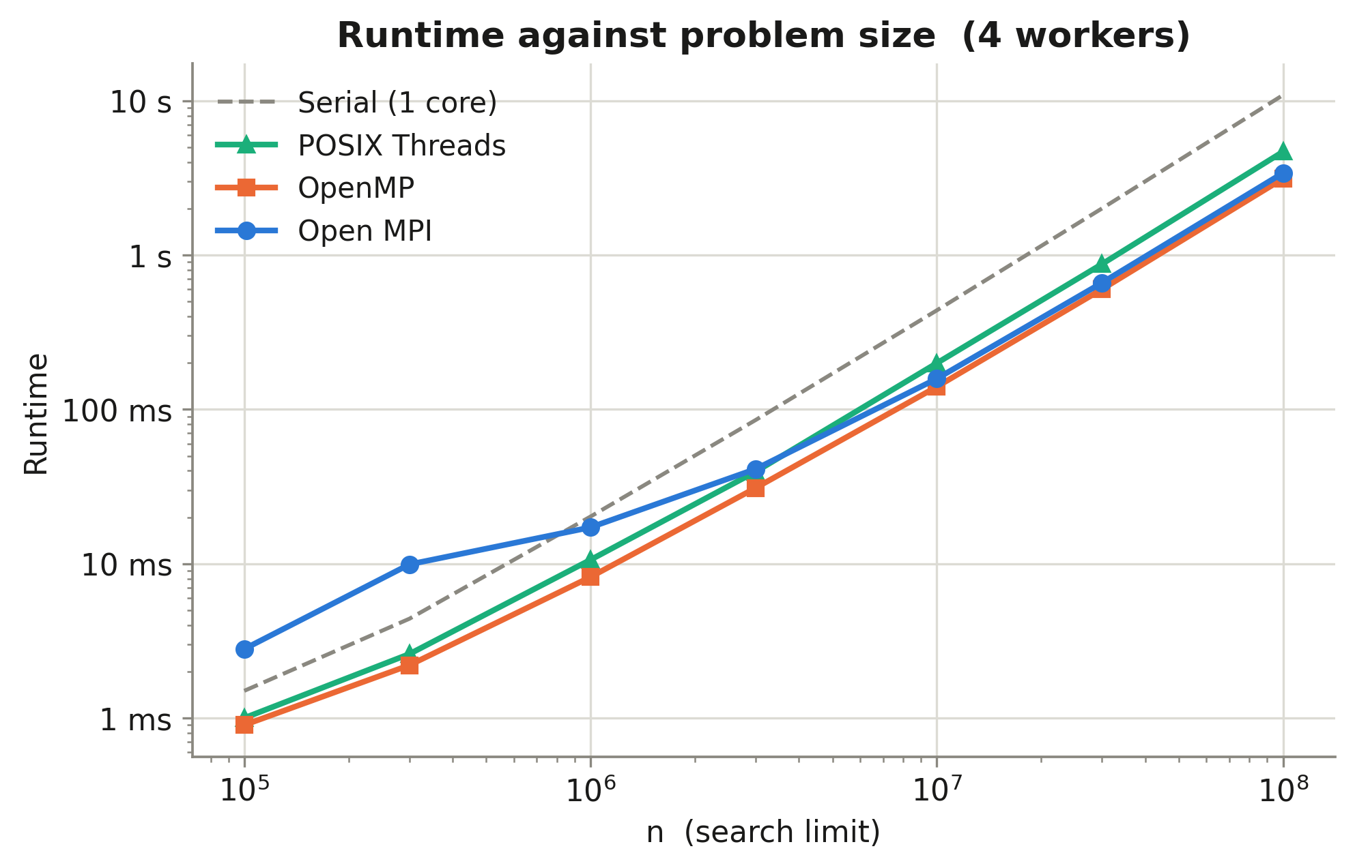
Lab 1 vs Lab 2 comparison graphs
There is significant overhead at lower n for Open MPI (as discussed earlier), but OpenMP and MPI end up converging, and POSIX threads ends up the worst solution, due to the contiguous block splitting (that we “fixed” with slices in MPI).

Slide 12
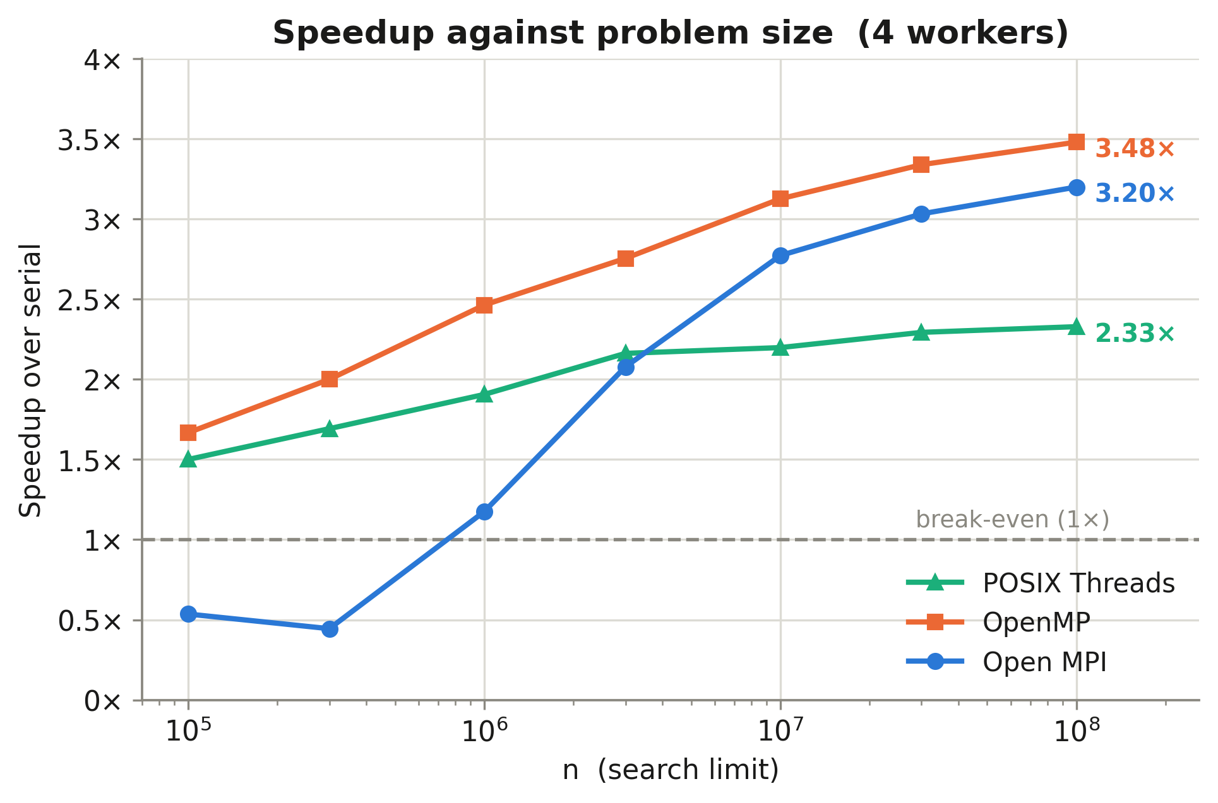
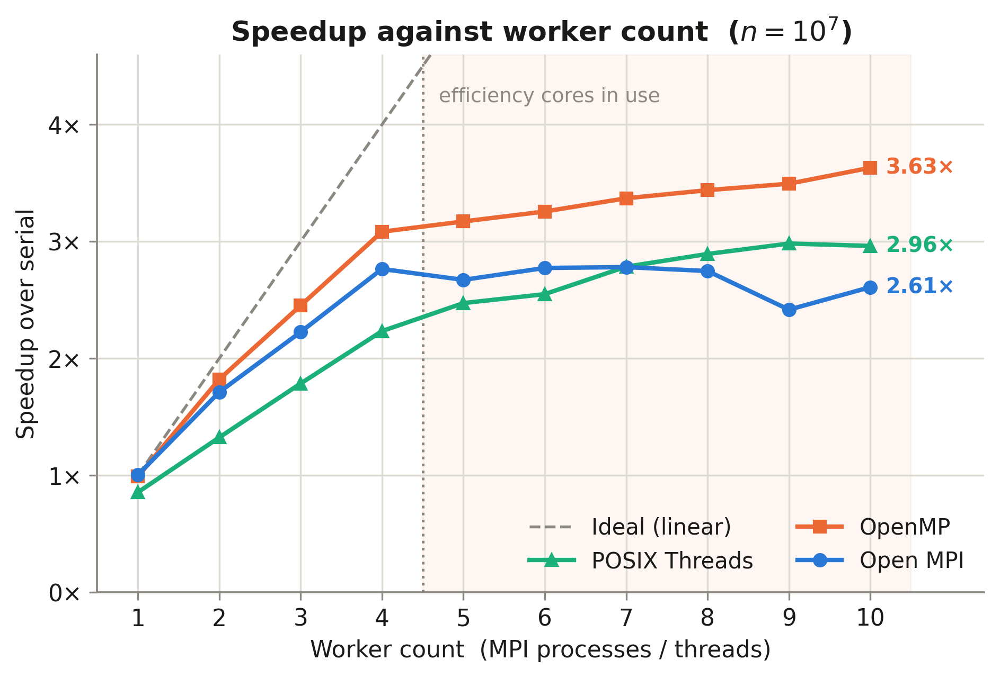
OpenMP has the highest speed up, as OpenMPI has to gather and sort, which our OpenMP implementation does not need to do.

